Slide 1
Collections and inversional symmetry

Slide 2
Diatonic/Modal Collections
The major scale in successive rotations, therefore still diatonic;
C major=C Ionian; beginning on
D, Dorian; on E, Phrygian; on
F Lydian; on G Mixolydian; on
A, Aeolian; on
B, Locrian.
As with the major and minor scales, there are twelve forms (twelve distinct collections) of each mode.

Slide 3
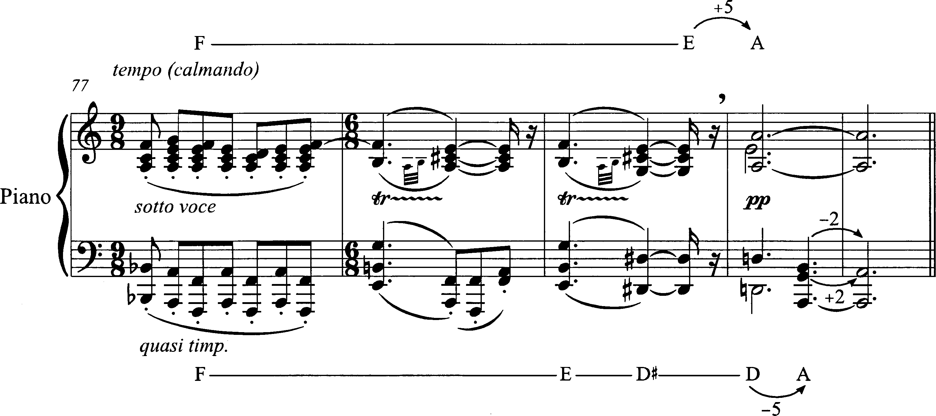
Cadential convergence on A,
Stravinsky, Serenade in A

Slide 4
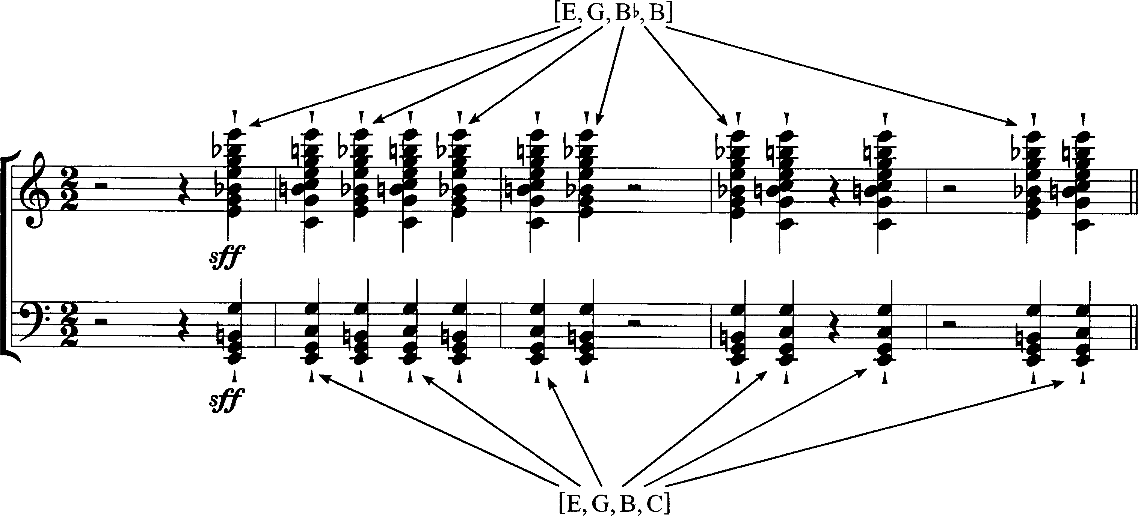
Cadential C vs. E
Stravinsky, Symphony in C, I, coda

Slide 5
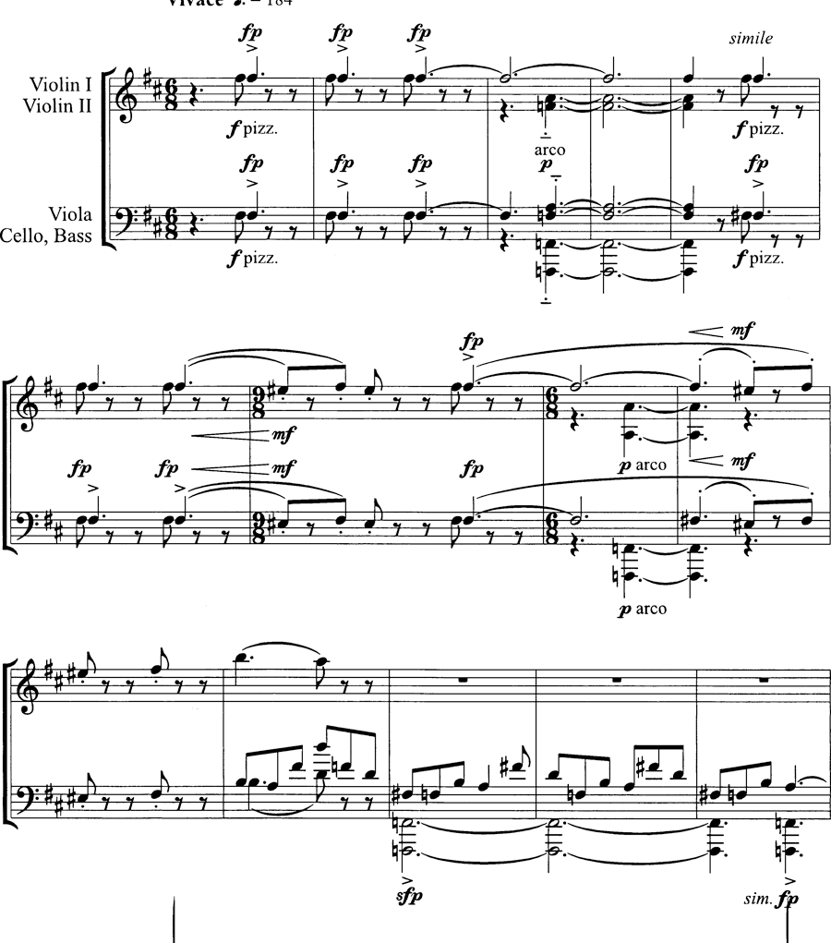
Opening Dm, DM, Bm triads
Stravinsky, Concert in D, I

Slide 6
Inversional Symmetry in Pitch Space

Slide 7
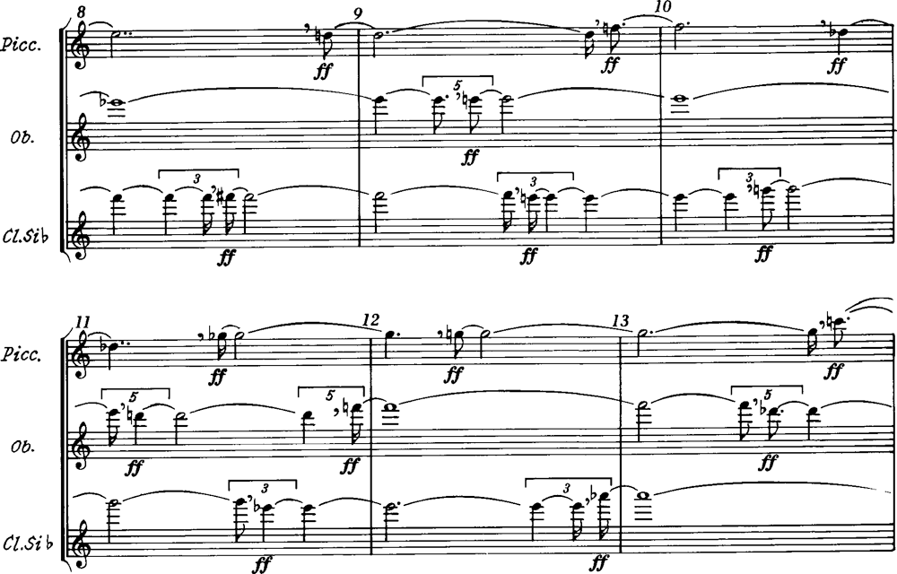
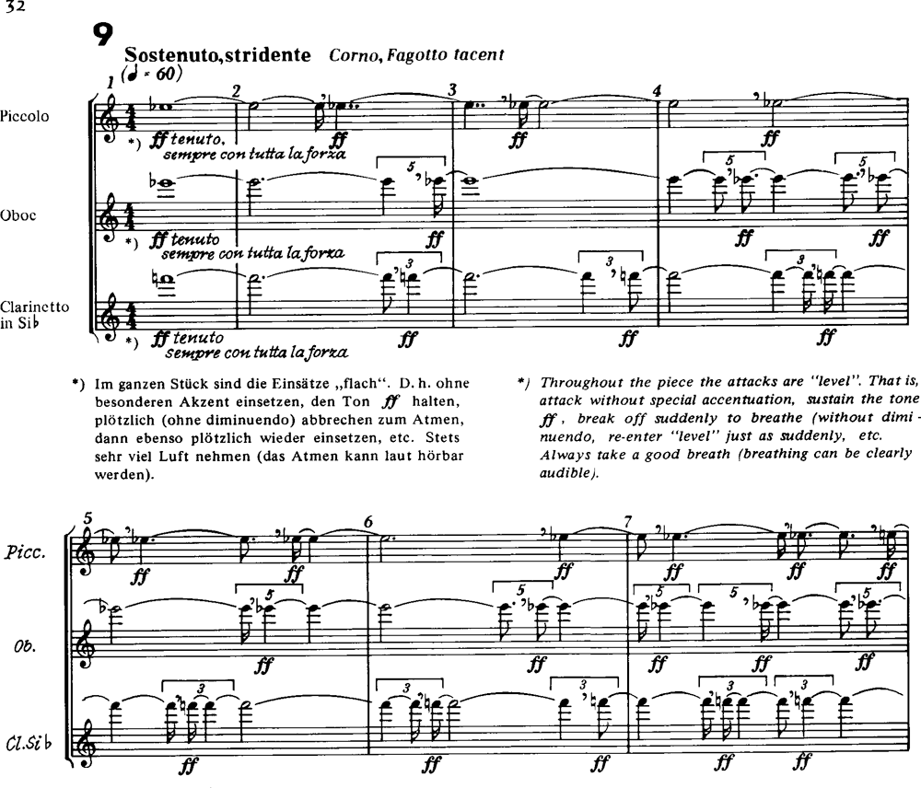
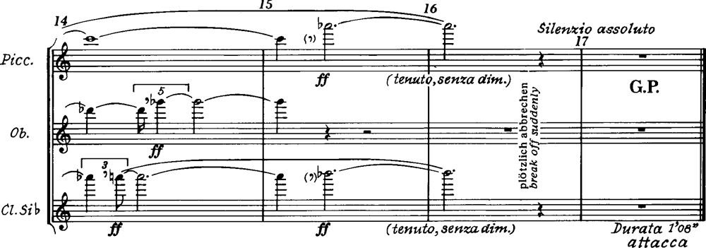
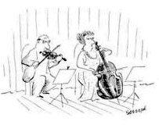
Inversional Wedges

Slide 8
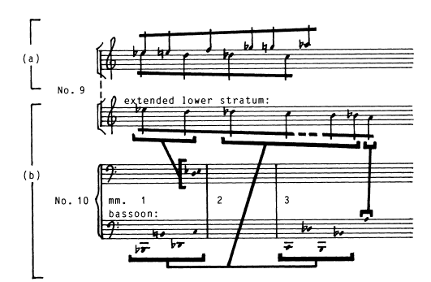

Slide 9
Symmetry around an Axis

Slide 10
Any two pitches are symmetrical around an axis

Slide 11
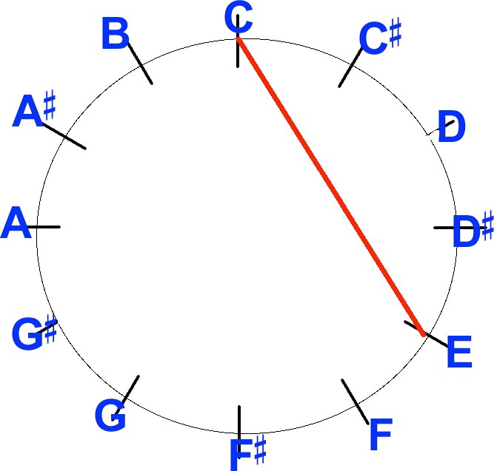
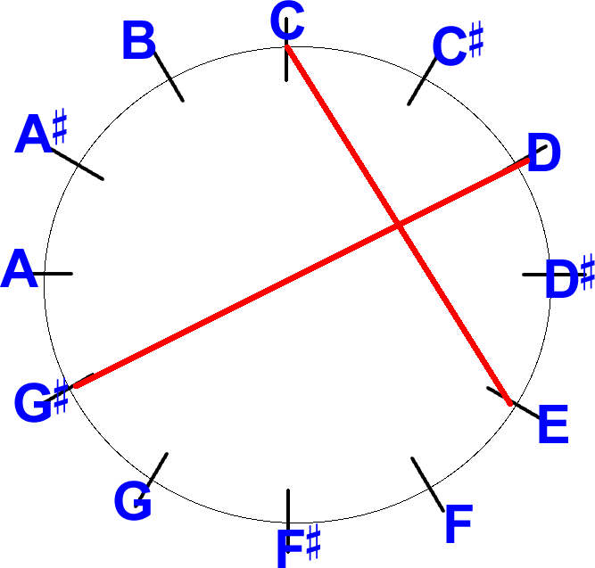
Axis = pitch or interval

Slide 12
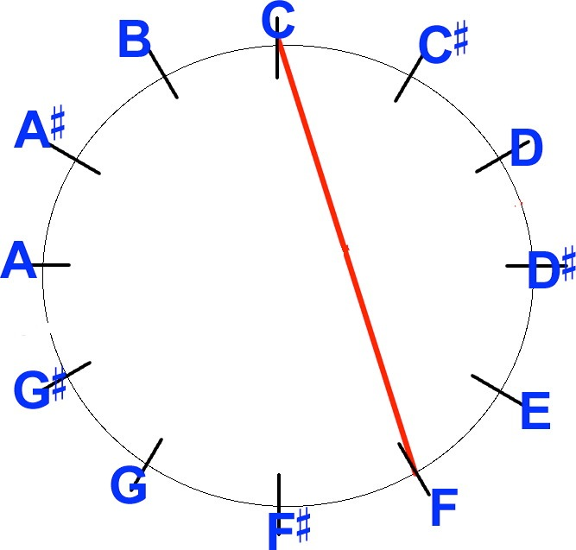
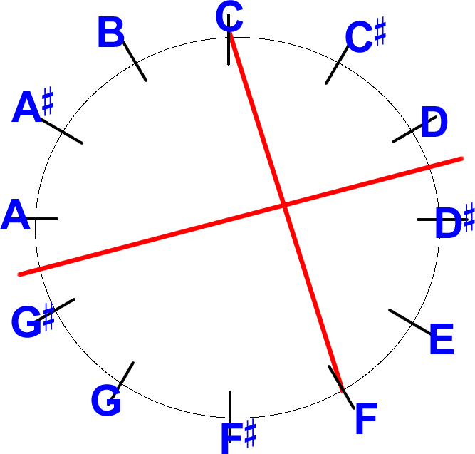
Axis = pitch or interval

Slide 13
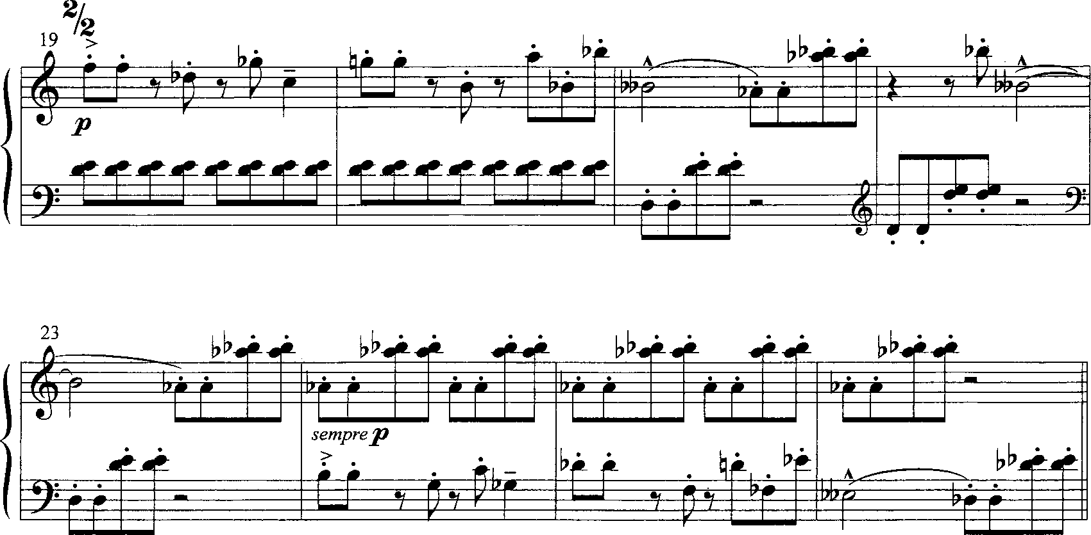
Double axis of symmetry Axis = E^{b} followed by A

Slide 14
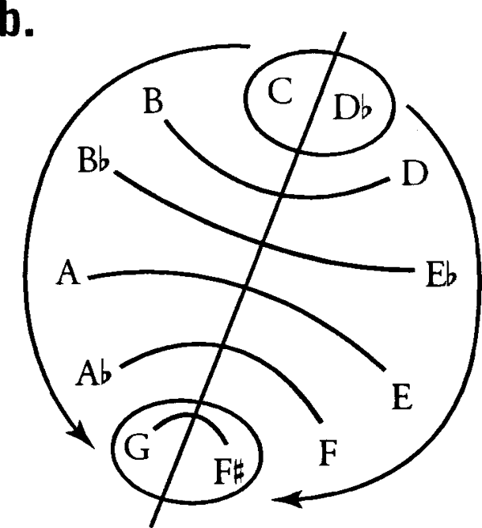
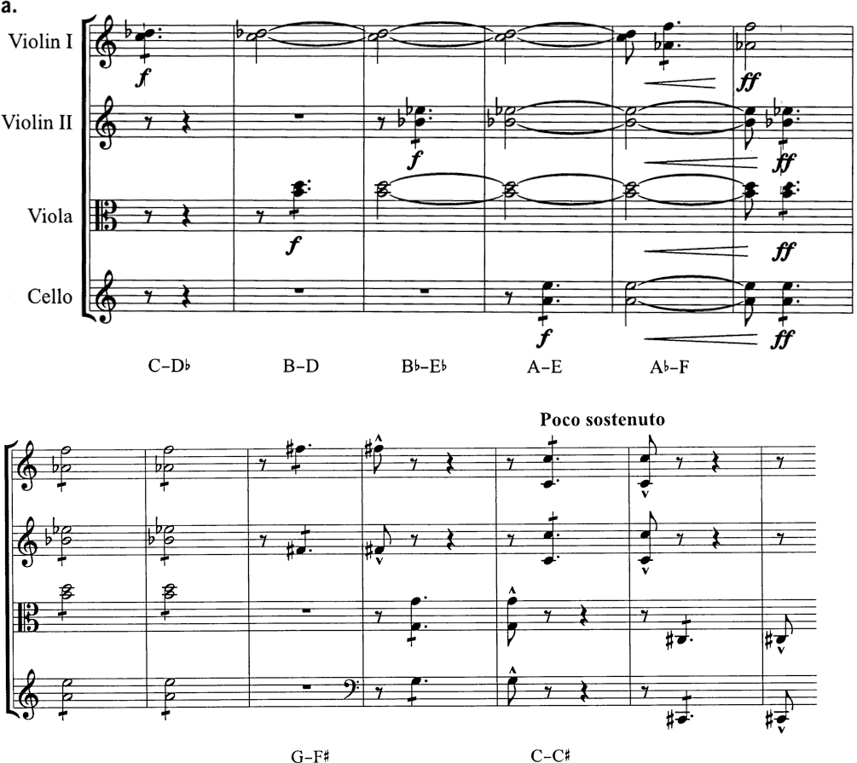
Bartók String Quartet No. 5, V

Slide 15
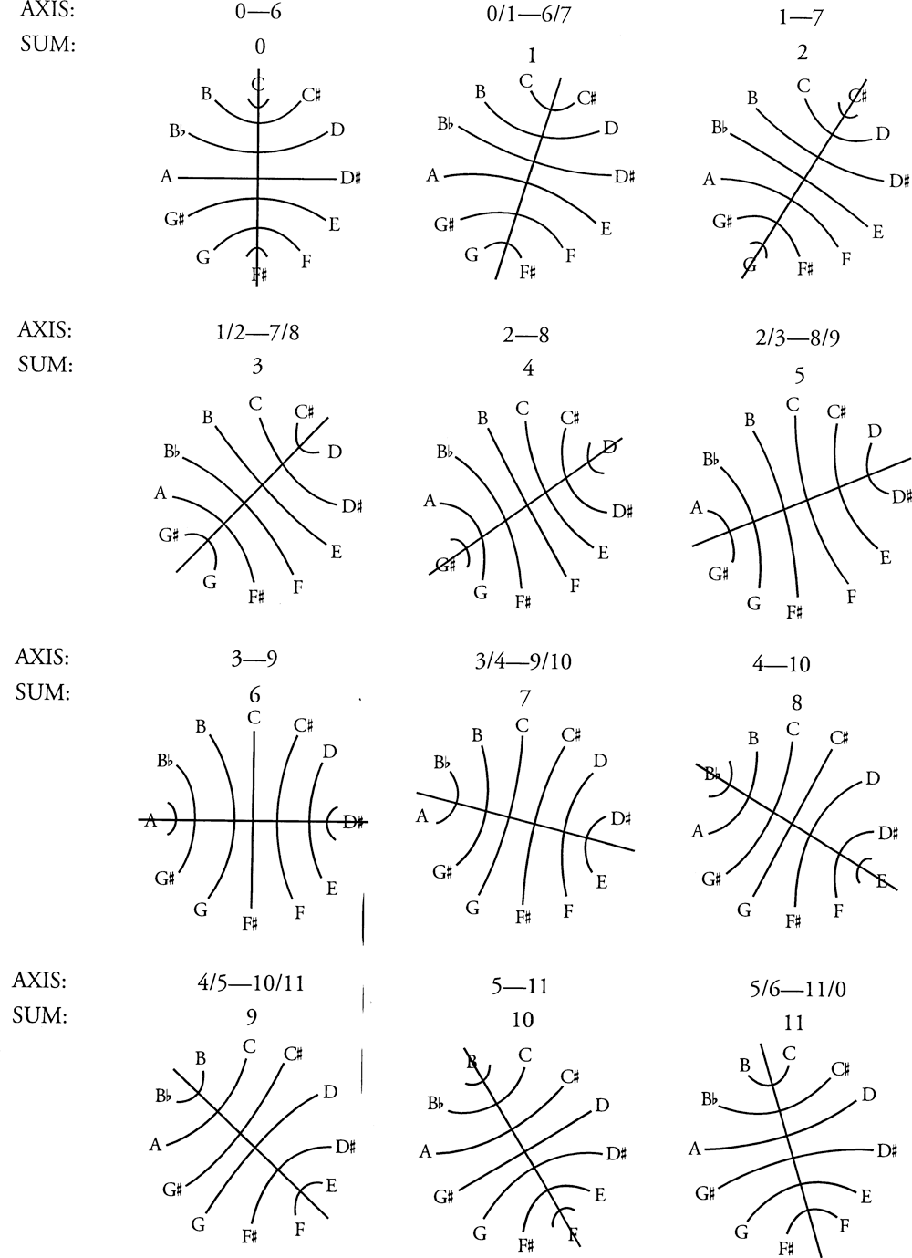

Slide 16
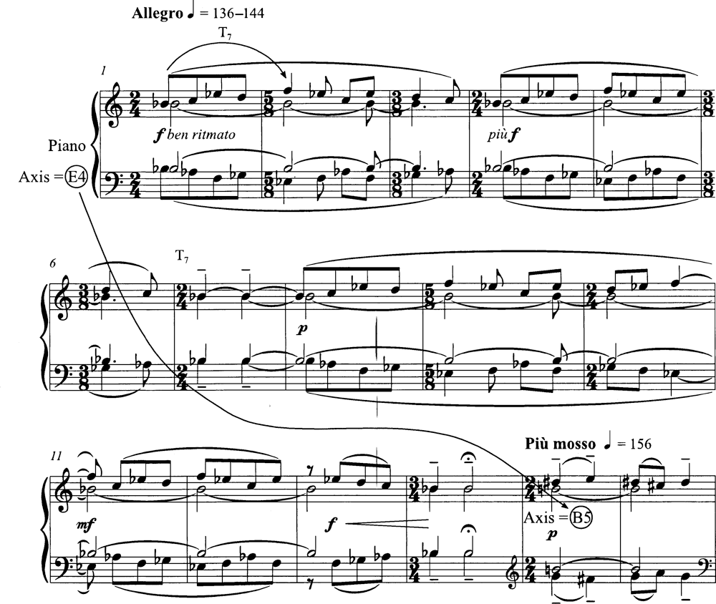
From one axis to another: Bartók, Mikrokosmos “Subject and Reflection”

Slide 17
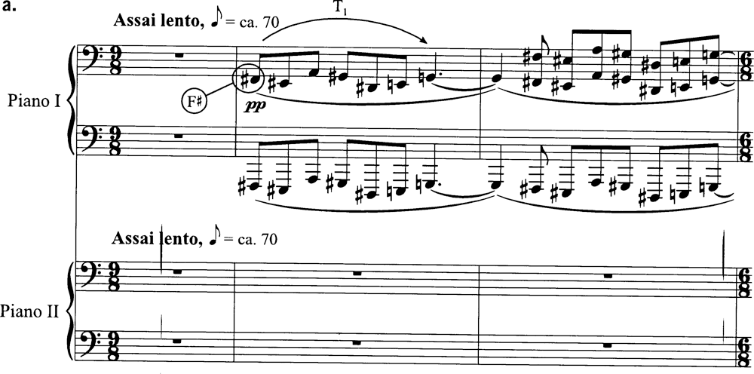
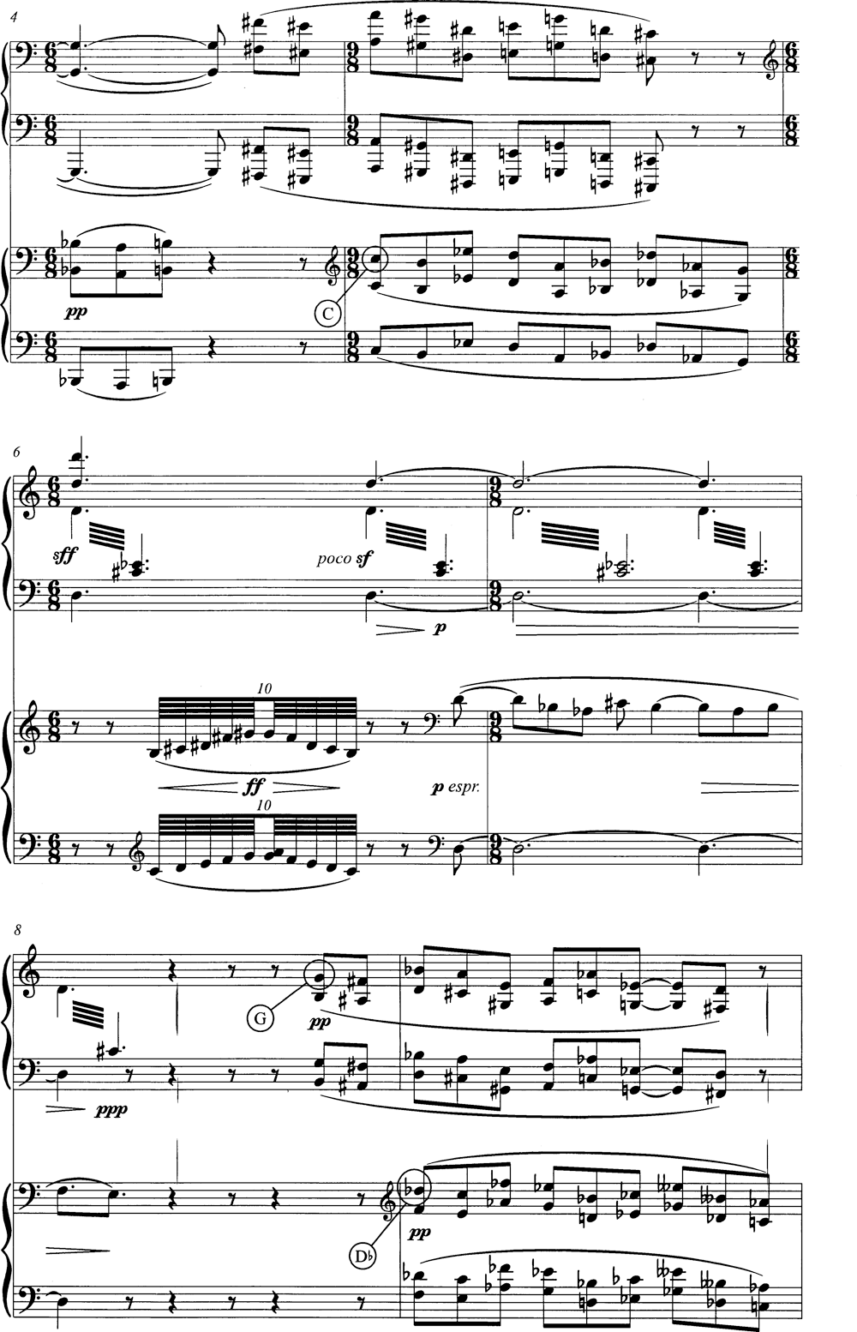

Slide 18
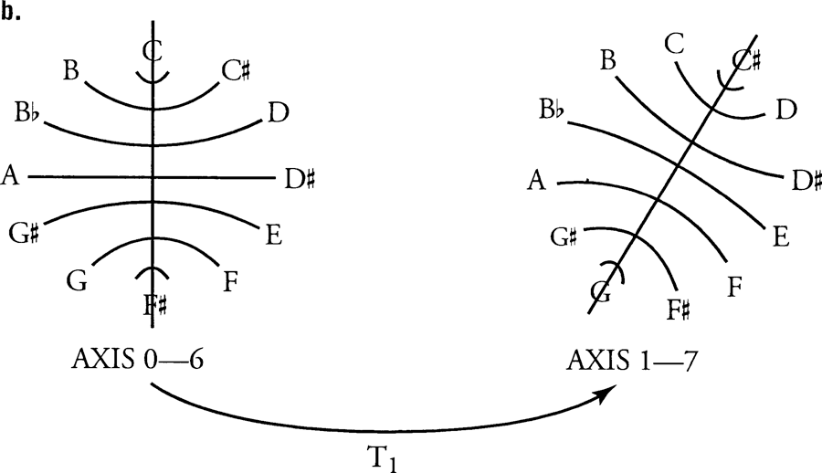

Slide 19
Diatonic/Modal Collections
Ionian 2-2-1-2-2-2-1 (Major Scale)
Dorian 2-1-2-2-2-1-2 (symmetrical; associated with mm7 chord)
Phrygian 1-2-2-2-1-2-2 (begins with 1, flat 7th)
Lydian 2-2-2-1-2-2-1 (major with #4)
Mixolydian 2-2-1-2-2-1-2 (major with flat 7th; associated with Mm7 chord)
Aeolian 2-1-2-2-1-2-2 (Natural minor)
Locrian 1-2-2-1-2-2-2 (begins with 1; flat 5th and flat 7th)

Slide 20
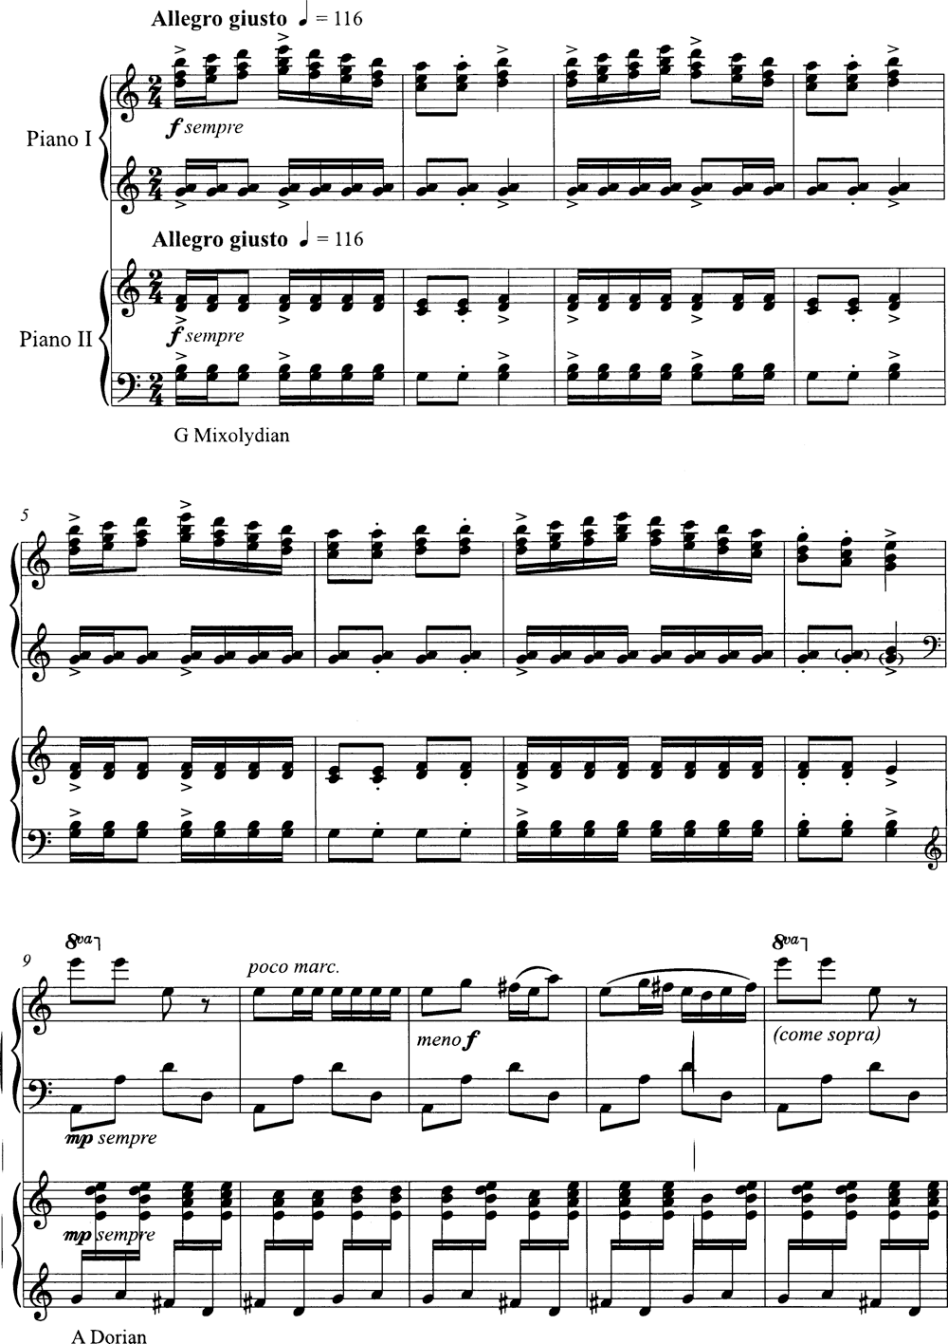
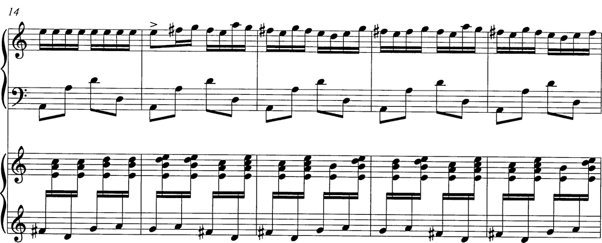

Slide 21
Diatonic collection names
DIA0#, DIA0b | C Ionian, D Dorian, E Phrygian, F Lydian, G Mixolydian, A Aeolian, B Locrian
DIA1# | C Lydian, D Mixolydian, E Aeolian, F# Locrian, G Ionian, A Dorian, B Phrygian
DIA2# | C# Locrian, D Ionian, E Dorian, F# Phrygian, G Lydian, A Mixolydian, B Aeolian
DIA3# | C# Phryg., D Lydian, E Mixolydian, F# Aeolian, G# Locrian, A Ionian, B Dorian
DIA4# | C# Aeolian, D Dorian, E Phrygian, F Lydian, G Mixolydian, A Aeolian, B Locrian
DIA5# | C# Dorian, D Dorian, E Phrygian, F Lydian, G Mixolydian, A Aeolian, B Locrian
DIA6#, DIA6b | C# Mixolydian, D# Aeolian, E# Loc., F# Ionian, G# Dorian, A# Phry., B Lydian
DIA5b | C Locrian, Db Ionian, Eb Dorian, F Phry., Gb Lydian, Ab Mixo., Bb Aeolian
DIA4b | C Phryg., Db Lydian, Eb Mixolydian, F Aeolian, G Locrian, Ab Ionian, Bb Dorian
DIA3b | C Aeolian,D Locrian, Eb Ionian, F Dorian, G Phry., Ab Lydian, Bb Mixolydian
DIA2b | C Dorian, D Phrygian, Eb Lydian, F Mixolydian, G Aeolian, A Locrian, Bb Ionian
DIA1b | C Mixolydian, D Aeolian, E Locrian, F Ionian, G Dorian, A Phrygian, Bb Lydian

Slide 22
Stravinsky, The Rake’s Progress
Act I, Sc I, The Woods are Green

Slide 23
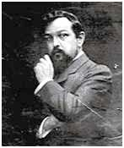
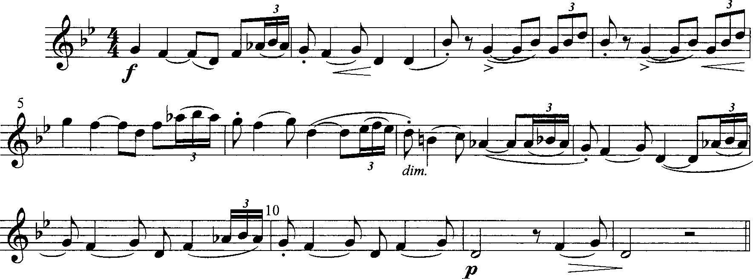
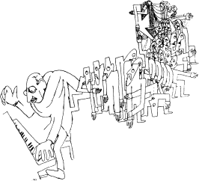
String Quartet I, mm. 1-12, vn 1

Slide 24
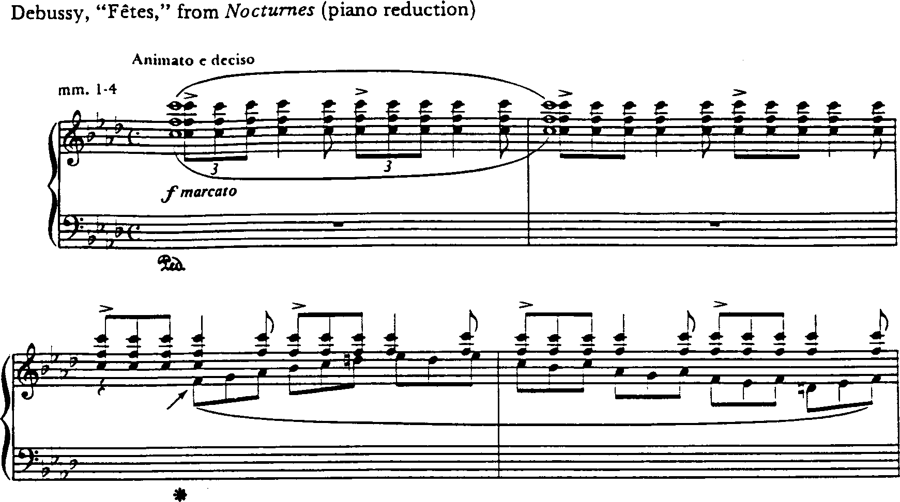
How would you determine pitch center and mode in the following?

Slide 25
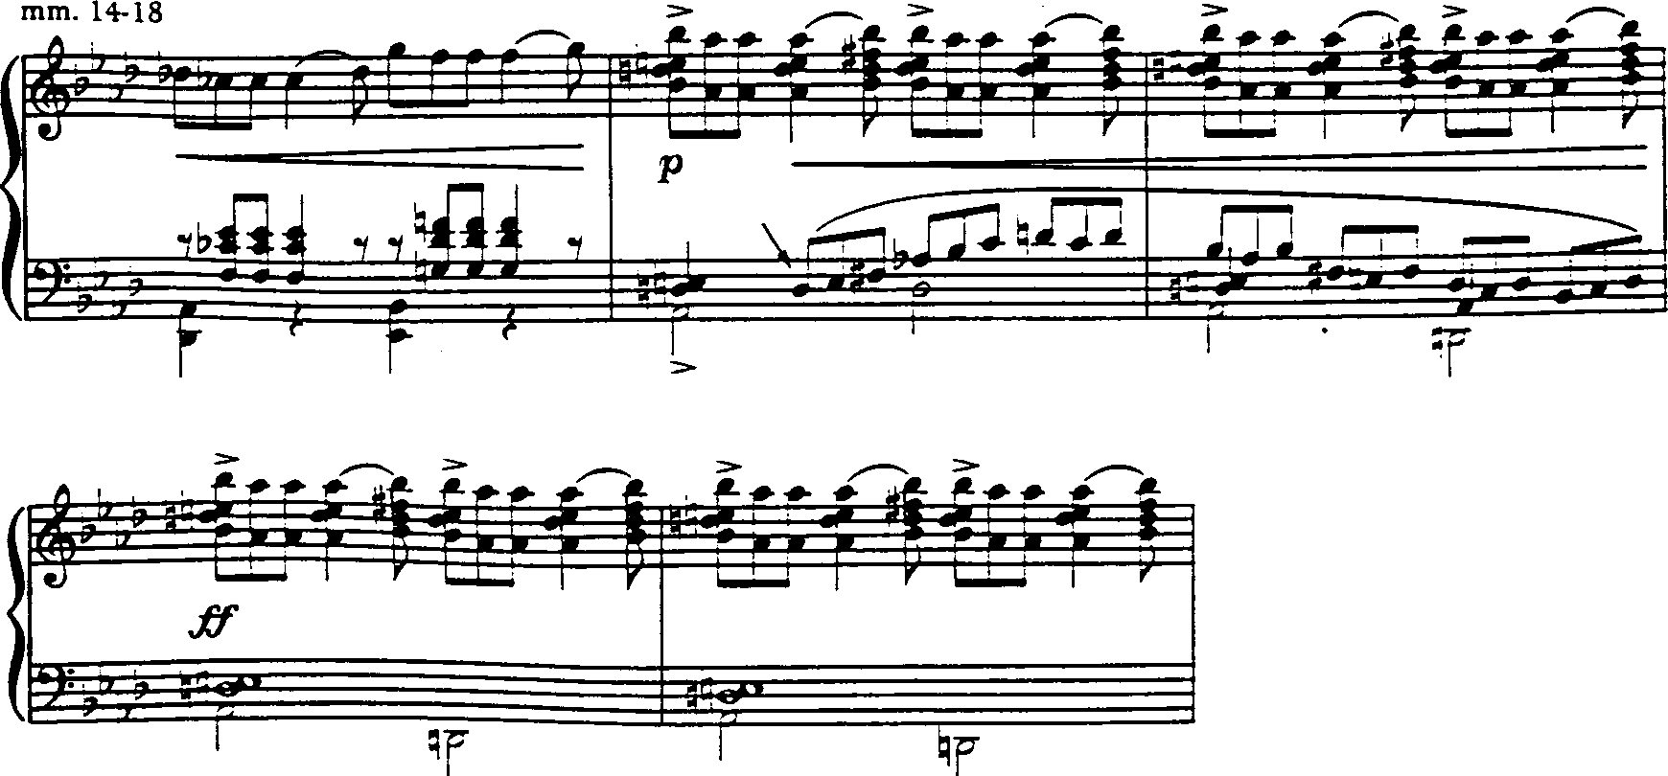

Slide 27
Anhemitonic Pentatonic Collections
No half steps, two non-consecutive thirds: 2-2-3-2-3.
Rotations of standard C anhemitonic pentatonic

Slide 28
Anhemitonic Pentatonic Collections
No half steps, two non-consecutive thirds: 2-2-3-2-3.
The pentatonic scales are:
C-D-E-G-A C#-D#-F-G-A#
D-E-F#-A-B D#-F-G-A#-C#
E-F#-G#-B-D F-G-A-C-D
F#-G#-A#-C#-D# G-A-B-D-E
G#-A#-C-D#-F# A-B-C#-E-F#
A#-C-D-F-G B-C#-D#-F#-G#

Slide 29
Once again--12 forms (all complements of the 7 diatonic tones that compose a mode; i.e., each mode paired with one form of pentatonic will form the complete chromatic).

Slide 30
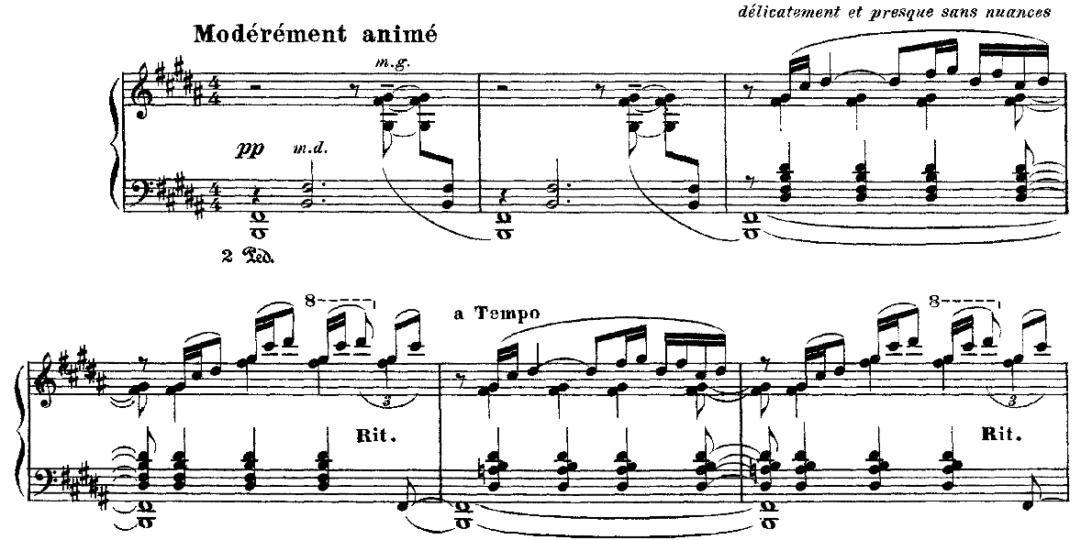
“Pagodes,” from Estampes

Slide 31
Modal IDs
Only 5 notes - but is it pentatonic?

Slide 32
Modal IDs

Slide 33
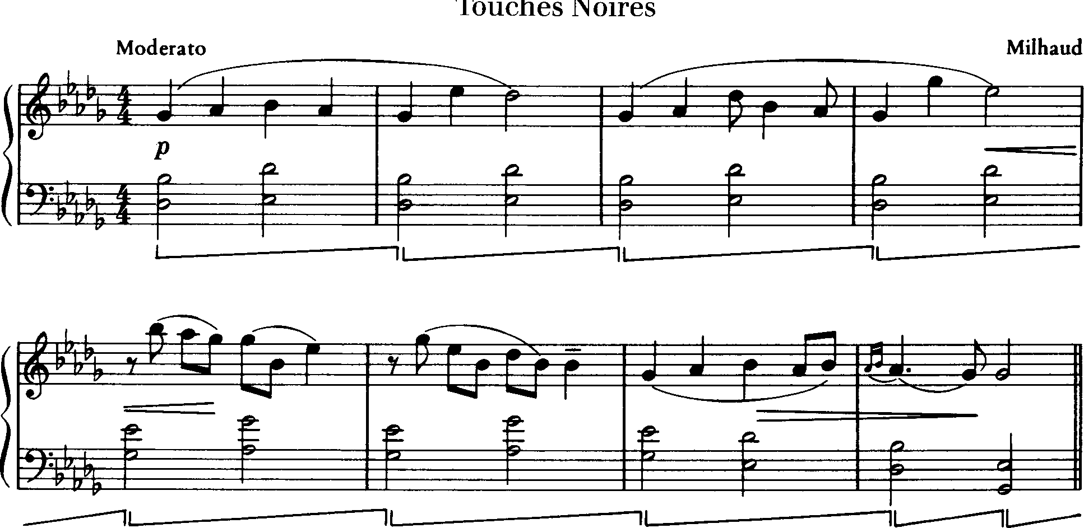

Slide 34
More modal IDs
This is the acoustic scale - not covered in your text
C-D-E-F#-G-A-Bb-C
2-2-2-2-1-2-1-2
What two scales seem to combine here?

Slide 35
The Octatonic Scale
OCT (0,1) =
Octatonic collection with pc 0 & pc 1

Slide 36
Octatonic as transpositional combo

Slide 37
Below lists the 11 tetrachordal partitions of the source collection and the 9 dyadic partitions. The 11 tetrachords represent 7 different classes of tetrachords.
0134 = harmonic minor collection;
0235 = lower half of a minor scale (what I call the Dorian tet);
0347 = major/minor triad
0268 = French sixth,
0358 = minor seventh
0369 = diminished seventh
only 0167 resists traditional interpretation.

Slide 38
The octatonic’s dyadic partitions represent each of the six available dyad-classes; the only other collection like that is the 12-pitch-class aggregate.

Slide 39
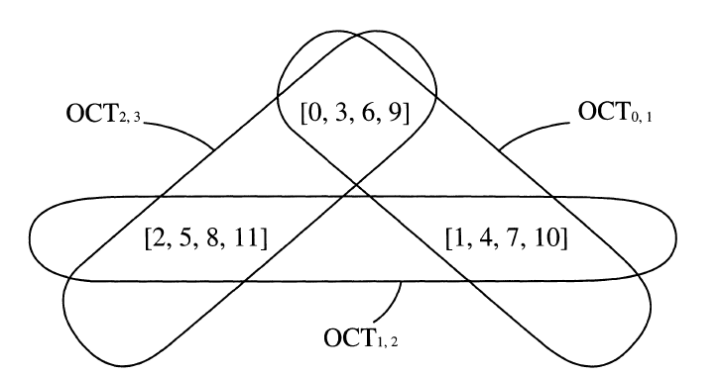

Slide 40
Pitch centricity
in the Octatonic scale
Double pitch-class center
Pitch-class complex
Bartók, “Diminished Fifth,” Mikrokosmos vol. 4, #101

Slide 41
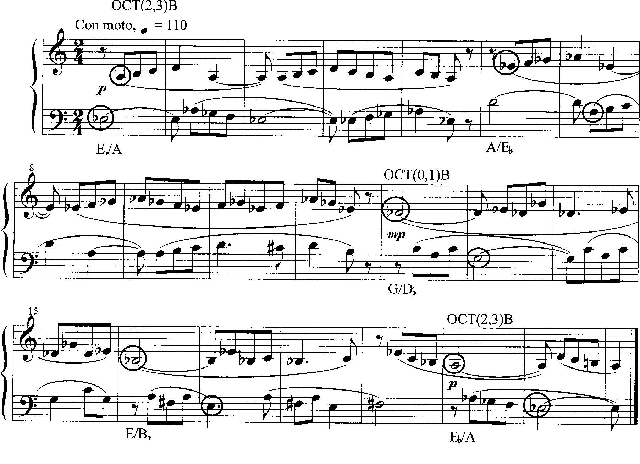

Slide 42
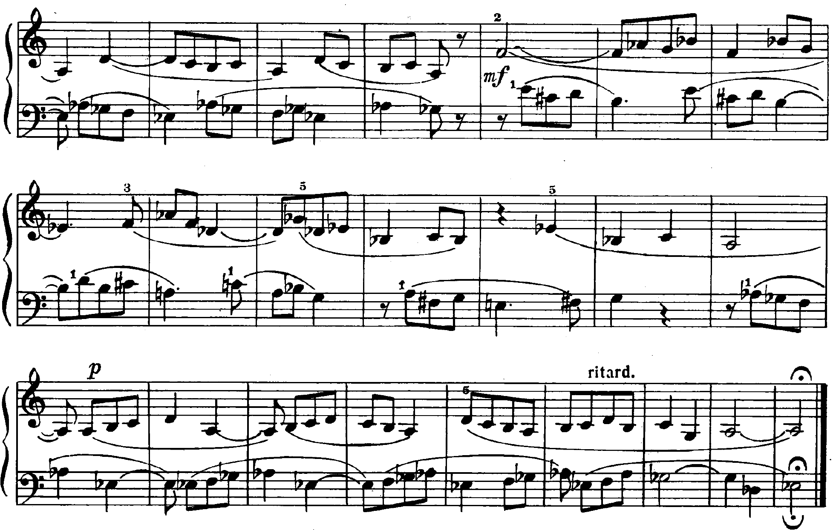
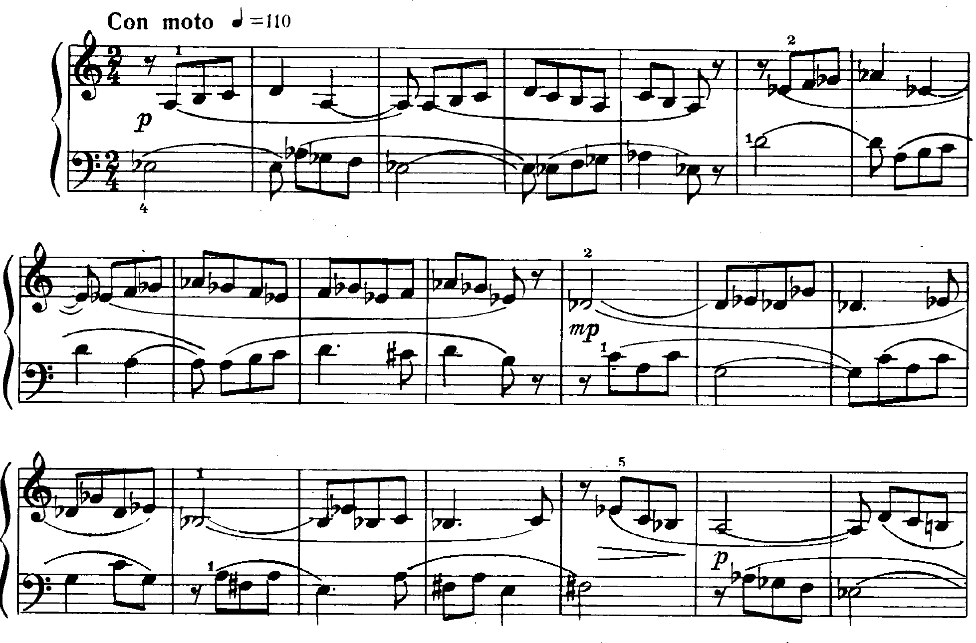
OCT1,2
OCT2,3
OCT0,1
OCT0,1
OCT2,3
OCT2,3

Slide 43
Symmetrical Scales
Even and Odd Whole Tone

